Slide 1
Helen Donlon
Community Capacity Officer
Summer/ Autumn Blog 2019
The Deal for Communities Team
Notes:
.

Slide 2
Welcome
Name: Helen Donlon
Job title: Community Capacity Officer
Areas responsible: Atherton, Astley, Tyldesley and Mosley Common
Contact email: H.Donlon@wign.gov.uk
Tel: 01942 486768/ 07921092550
Hello and welcome to my first community blog! In case we haven’t been introduced, I am the new Community Capacity Officer in the Deal for Communities team. I have been in post for around six months now and I am really settling into the team. This blog contains information about myself, my role within the team, what I have been up to and an overview of any groups I have visited across the area or projects that I have supported or been involved with.
I would firstly like to thank everyone who I have so far met across the Atherton, Astley, Tyldesley and Mosley Common areas. Your understanding, advice and support has allowed me to grow and develop my skills and knowledge which is invaluable to my engagement and support across communities. I still have a lot of people to meet and I am on the look out for any community or voluntary groups who may need any project support or capacity building in their area.
I do hope you enjoy my first blog and please feel free to share with any of your key contacts across your local community.
I hope to see you soon.
Best wishes,
Helen.
Notes:
Joanne: First off I just want to touch on a bit of house keeping - toilets, drinks, & mobile phones if there's a fire

Slide 3
About my role
Name: Helen Donlon
Job title: Community Capacity Officer
Areas responsible: Atherton, Astley, Tyldesley and Mosley Common
Contact email: H.Donlon@wign.gov.uk
Tel: 01942 486768/ 07921092550
My Role:
My role allows me to explore, support and build up community capacity across local areas. I encourage local communities to promote their assets and initiative in a way that will allow them to become sustainable and retain their passion for their local area. My responsibilities include constant consultation and engagement with existing and new community groups within my assigned area. I constantly look for any gaps in communities that we as a team and wider council are not aware of; this could involve a strong community group, presence or service which could benefit a lot of people who are working in a close proximity to them. I must ensure that community groups are aware of who I am and how I can help them promote and develop project ideas.
As well as community consultation, I work with my team on tenant and resident engagement through listening to feedback, issues and concerns. This side of my work allows me to build networks with key public service and council officers such as: GMP, GMFRS, NHS, Housing, Environment and Community link workers.
Our team’s Deal for Communities Investment Fund is also on its 7th round and has a clear focus of investment for children, young people and families. As a Community Capacity Officer, I must share this strategy with as many contacts that I have who I feel would greatly benefit from this investment opportunity. If an individual has a unique idea and can show evidence that they have consulted with their community and that there is a need for their project; I will be able to support them with progress and advise them on capacity of the project and who they would be able to work in partnership with.
My Priorities over the next few months:
To have clear and thorough knowledge about what is going on across my assigned communities
To plug any gaps that we as a council might not be aware of, whether this be linked to communities or tenants and residents
To host regular community network meetings for all voluntary, community and resident groups to attend. This enables them to make links with each other and their unique services, in order to build up community capacity
To share and present our strategy for the Community Investment Fund for Round 7 (CIF 7) to any children, young people and family services such as schools, youth groups and uniformed services
To evaluate any groups which I have been assigned and ensure that they have a strong relationship and support with myself
To support and lead on current corporate projects that I have been assigned, such as our team website and social media engagement, Our Town Campaign and the BeWigan Communities experience
Notes:
Joanne: First off I just want to touch on a bit of house keeping - toilets, drinks, & mobile phones if there's a fire

Slide 4
Community Investment Fund Update

Slide 5
The Deal for Communities Investment Fund Round 7
Round 7 open NOW: September 2019 – 16th February 2020
What is it?
The Deal for Communities Investment Fund (DFCIF) is an exciting opportunity for people to make a real difference and solve some of Wigan borough’s biggest social problems.
The funding forms part of The Deal, which enables residents to get involved in their community.
Since its launch in 2013, we've supported community groups and projects working towards improving outcomes for local residents with £10m invested to date. This demonstrates how committed we are to supporting local communities.
Take a look on our team webpage, for more information on guidance, levels of investment and projects that we have funded in the past - https://www.wigan.gov.uk/council/the-deal/deal-communities/communities-investment-fund.aspx
Workshops
In partnership with the Wigan Borough Community Partnership, The Deal for Communities Team are currently hosting 6 workshops across the borough which focus on the application process of Round 7 for The Deal for Communities Investment Fund. All interested applicants were encouraged to attend, particularly as this years investment has a completely new focus and vision of investment priorities.
Dates:
St. Peter’s Pavilion, Wednesday 2nd October
Worsley Hall Community Centre, Monday 14th October
The Turnpike, Leigh, Friday 1st November
MORE DATES ARE CURRENTLY BEING SCOPED DEPENDANT ON DEMAND AND EXPRESSIONS OF INTEREST – PLEASE KEEP A CLOSE EYE ON OUR WEBPAGE FOR FURTHER INFORMATION!

Slide 6
Case Studies
What has been going on across the area?
What have I been up to?
Where have I visited?
Notes:
Joanne: First off I just want to touch on a bit of house keeping - toilets, drinks, & mobile phones if there's a fire

Slide 7
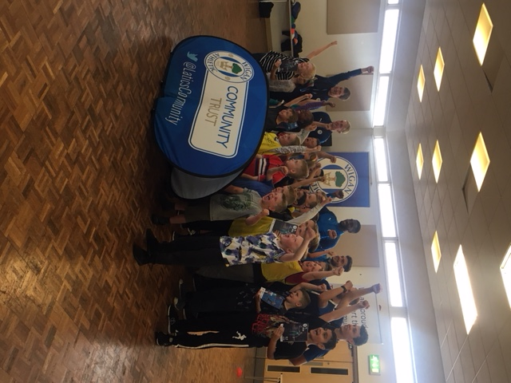
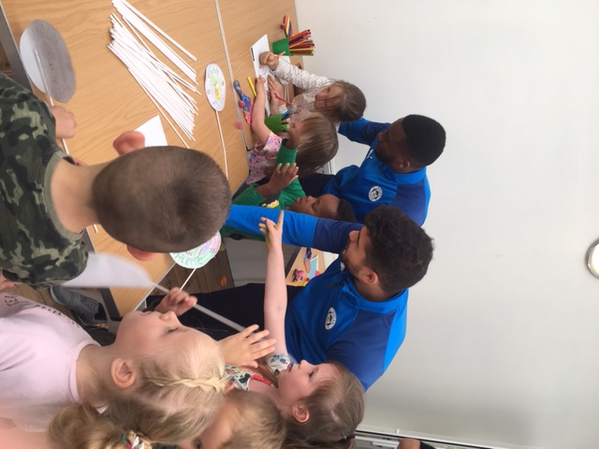
Fit & Fed Camp’s 2019, Dorset Road, Hag Fold, Atherton
12th August 2019
To celebrate the end of another successful summer season of this year’s Fit and Fed Camps, players from Wigan Athletic payed a surprise visit to Dorset Road Community Centre in Hag Fold Atherton. The players joined in with activities such as dodgeball and arts and crafts. Fit and Fed Camps are planned and delivered by a collaboration of services across the Wigan Borough. At Dorset Road, this included: staff from Meadowbank Primary School and Start Well Centre, Community Capacity Officers, Inspiring Healthy Lifestyles, Wigan Athletic Community Trust and many fantastic Wigan Council Staff and Community Volunteers. The purpose of the summer camps is to ensure that children have access to sports, games, social interaction and a nutritious meal. Thank you to all who played a part in providing a fantastic four weeks for children across the borough.
‘A fantastic surprise for all of the children and a great way to mark the end of the Fit and Fed Camps for Summer 2019.’
“The project is recognised significantly by local retailers such as Waterfields and Tesco, who provide refreshments for the children to have during the day.”
‘A lot of hard work and commitment from a variety of services make this project so exciting and worthwhile for all involved.’
Next Steps:
Planning for next year
Developing new activities and ideas for the children
The camps are growing across the borough in a variety of areas – we must keep up to date by checking in with local schools and Start Well Centres.
Notes:
Joanne: First off I just want to touch on a bit of house keeping - toilets, drinks, & mobile phones if there's a fire

Slide 8
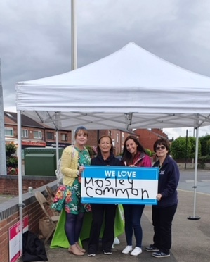
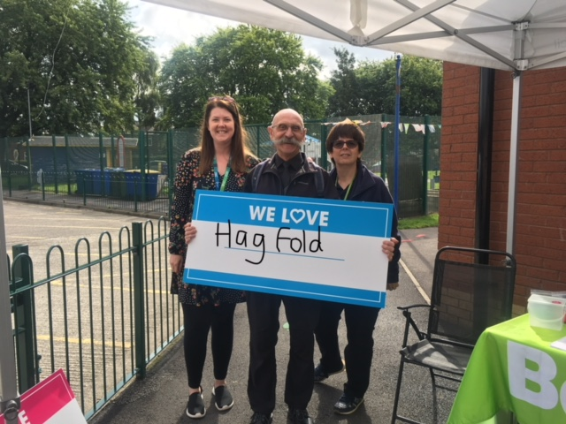
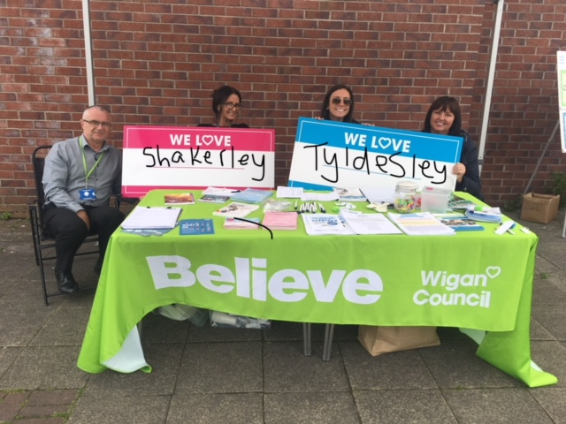
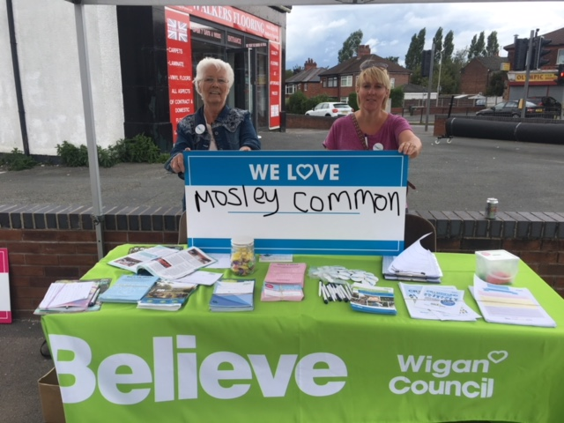
Talk with Tenants 2019
21st August 2019. Hag Fold, Shakerley and Mosley Common
Throughout a week in August 2019, The Deal for Communities team co-ordinated and embarked on some consultation and engagement with Tenants and Residents across the borough. Over on the east side of the borough, colleagues from Wigan Council and Public Services such as: Community Capacity officers, The Police, Elected Members, Environmental officers, Housing officers, and Customer Service all consulted with tenants and residents from Hag Fold, Shakerley and Mosley Common. Support on the day was also given by members of the Tenants Voice group. Being based in the heart of the communities allowed us to meet tenants and residents who we would have never met at a traditional area forum. It allowed new ideas to be discussed with residents about improvements and opportunities within their area; it also allowed any current or relevant issues that needed to be resolved to be done so by specific colleagues who were present at the consultation. Having a face to face conversation proved to create impact and understanding on what a local community wants to see more of from The Council services. All individual feedback was passed onto correct services, and the impact made is currently being reviewed, in order to understand whether this strategy would be a good way to engage with tenants on a regular basis going forward.
“20 people were spoken to on the day and 223 throughout the entire week of engagement across the borough”
‘Other areas covered included: Higher Folds, Westleigh, Golborne, Pemberton, Worsley Mesnes, Aspull, Scholes, Norley Hall, Platt Bridge, Stubshaw and Hindley”
‘It is fantastic to see Council services listening to tenants about their exact issues that they might be having and experiencing within their neighbourhood.”
Notes:
Joanne: First off I just want to touch on a bit of house keeping - toilets, drinks, & mobile phones if there's a fire

Slide 9
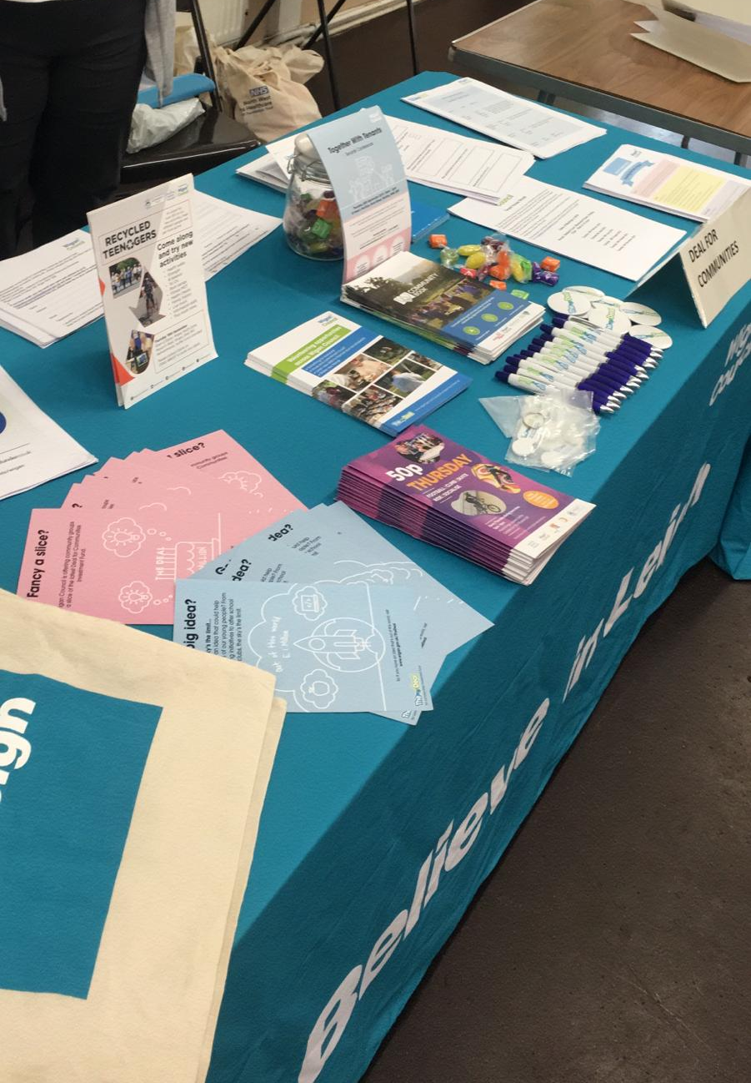
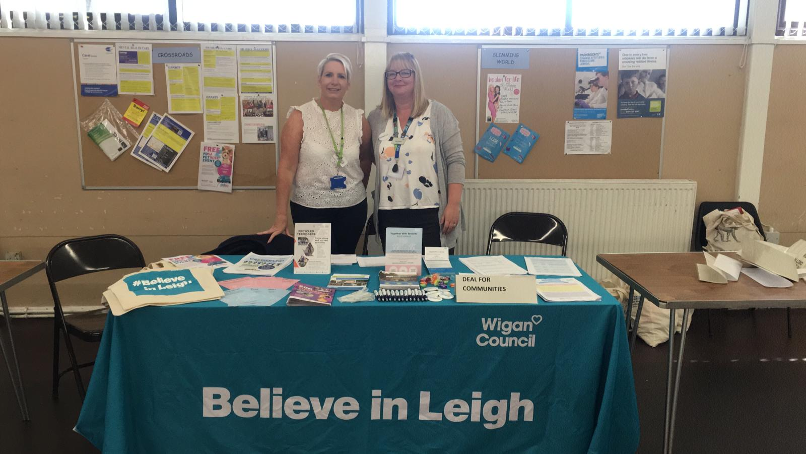
Mental Health Market Stall
Leigh Community Methodist Church – Friday 13th September
Officers from the Deal for Communities team attended a ‘Market Stall’ event which involved connecting and promoting services that aim to support people with their mental health. The Deal for Communities Team promoted their team offer and were able to sign individuals up to volunteering opportunities across the borough. The team were also able to signpost people to key groups that they could get in touch with in the area that they live, either to visit, volunteer or get in touch with. Having unique knowledge of Community networks in the local area, allowed connections to be made with other teams and organisations that work across the Wigan Borough.
Connections were made with services, organisations and community groups that we weren’t aware of, even though they are making quite an impact across the Wigan Borough. These individuals delivered a variety of projects that involve opportunities for children, young people, working and retired locals.
This was a fantastic opportunity to promote our Community Investment Fund Round 7 to groups that would greatly benefit from investment. Community knowledge was shared and details of the relevant Community Capacity Officers from the team have been shared and introduced to the relevant groups who were spoken to.
In total there were 17 stalls from different services and Community Groups such as: Joining Communities, Empathy North West CIC, Umbrella Arts and My Life were a few of the many connections made at this event.
‘A great opportunity to network with organisations from across the borough and make links into how The Deal for Communities Team can work with them.’
‘The Community Investment Fund is a unique opportunity that our organisation would greatly benefit from applying to. It was fantastic to find out more about it.’
Next Steps:
Another Mental Health Market Stall event is scheduled to take place in Wigan Town Hall on 14th November. It is hoped that these events will be ran regularly and will become well known across the community and local services.
Notes:
Joanne: First off I just want to touch on a bit of house keeping - toilets, drinks, & mobile phones if there's a fire

Slide 10
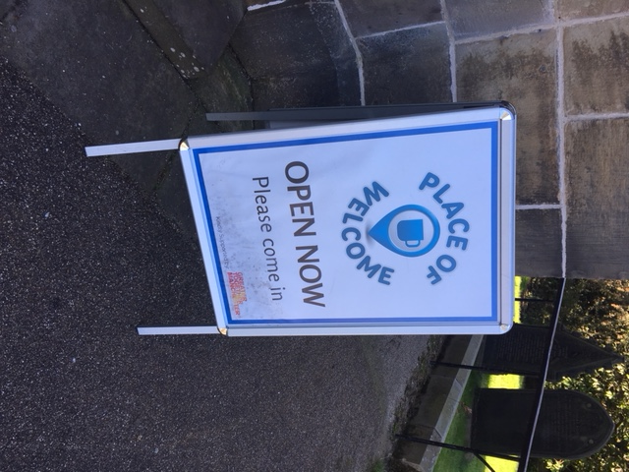
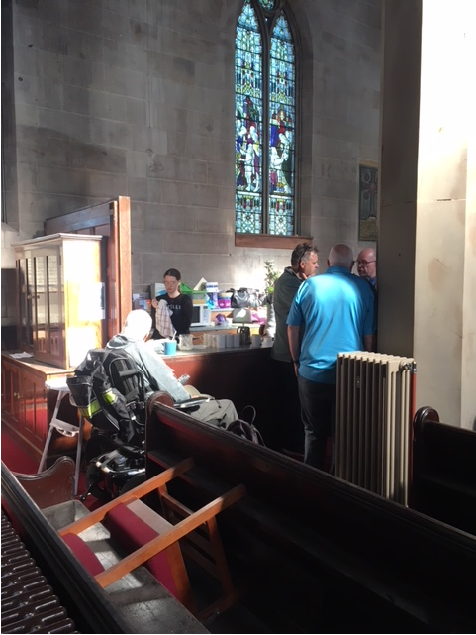
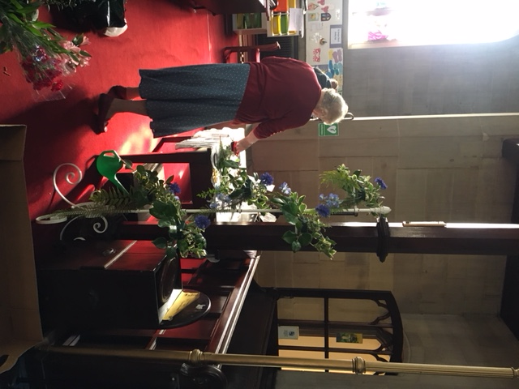
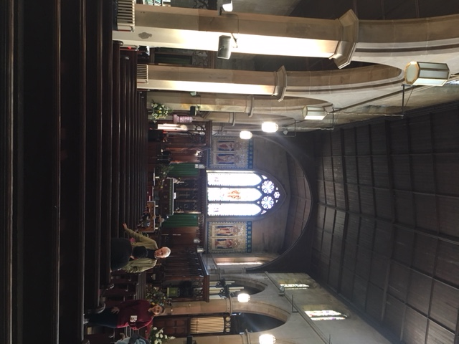
‘Place of Welcome’
Tyldesley St. George’s Church, every Friday 10am-12noon
Place of Welcome is a fantastic opportunity for local people, volunteers and services to socialise and share their personal stories, ideas and interests with each other. It is an initiative that brings the community of Tyldesley and surrounding areas together, to reduce social isolation but also to build up community networks and social groups. Everybody is welcome and they can get involved with the group as they are most comfortable and capable; this could be through socialising and meeting new people, assisting to make refreshments or arranging the flower displays in the local church. Individuals are able to freely communicate, relax and put their passions and skill into practice.
The group is attended by many generations. This ranges from new born and pre school children with their families, working age volunteers, retired volunteers and carers who bring somebody each week. Having such a wide range of attendance has occurred through the strong, positive, friendly and relaxed atmosphere that is offered at this group. The group is led by parishioners co-ordinated by Susan Mallon. Input is also present from Rector Martin Cox, who is keen to meet local people from across the community that he serves. No religious pressure is given at this group, the venue acts as a safe and welcoming place for people to drop in and attend as they please.
‘Our weekly group is an opportunity for all generations from all social and ethnic backgrounds to join together in unison as a cohesive community”
‘I look forward to seeing people every week and helping in the Café area, it allows me to give something back and become more socially active in my community.’
Notes:
Joanne: First off I just want to touch on a bit of house keeping - toilets, drinks, & mobile phones if there's a fire

Slide 11
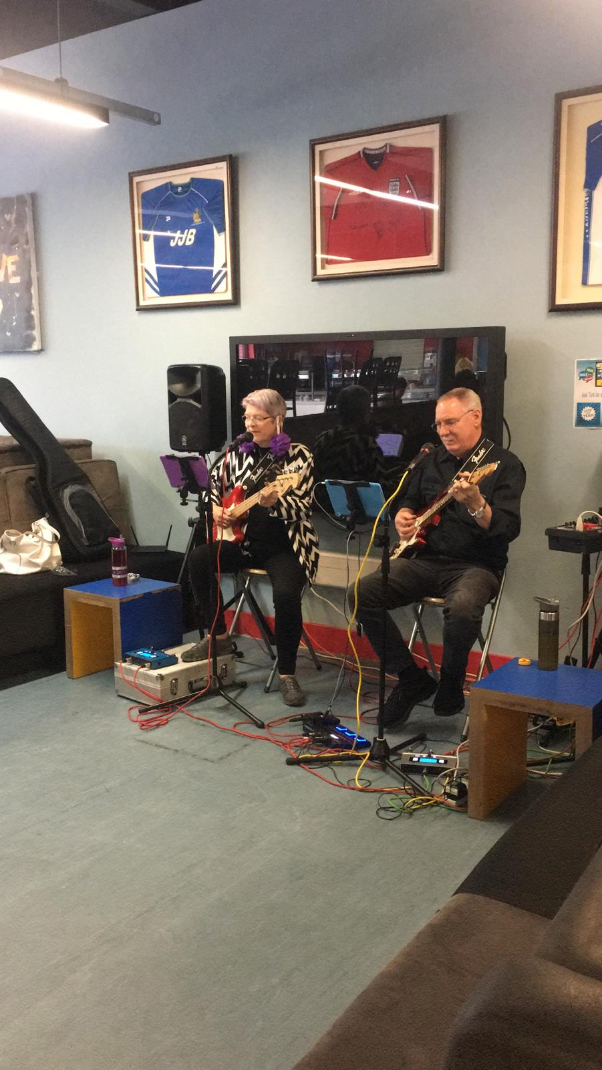
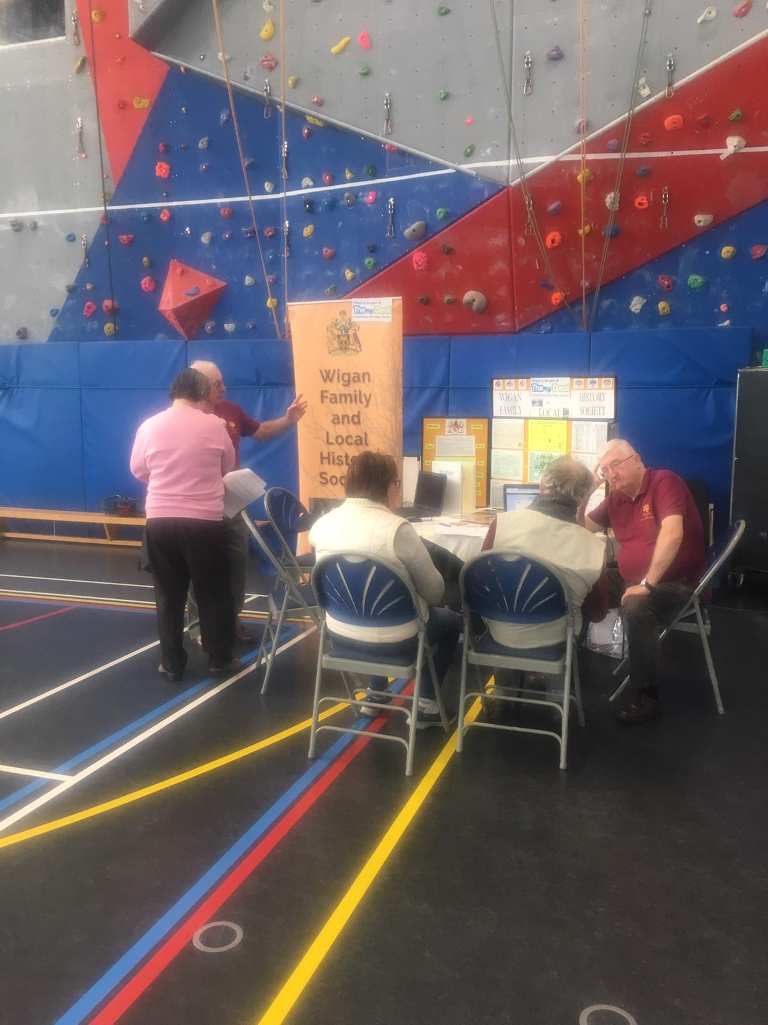
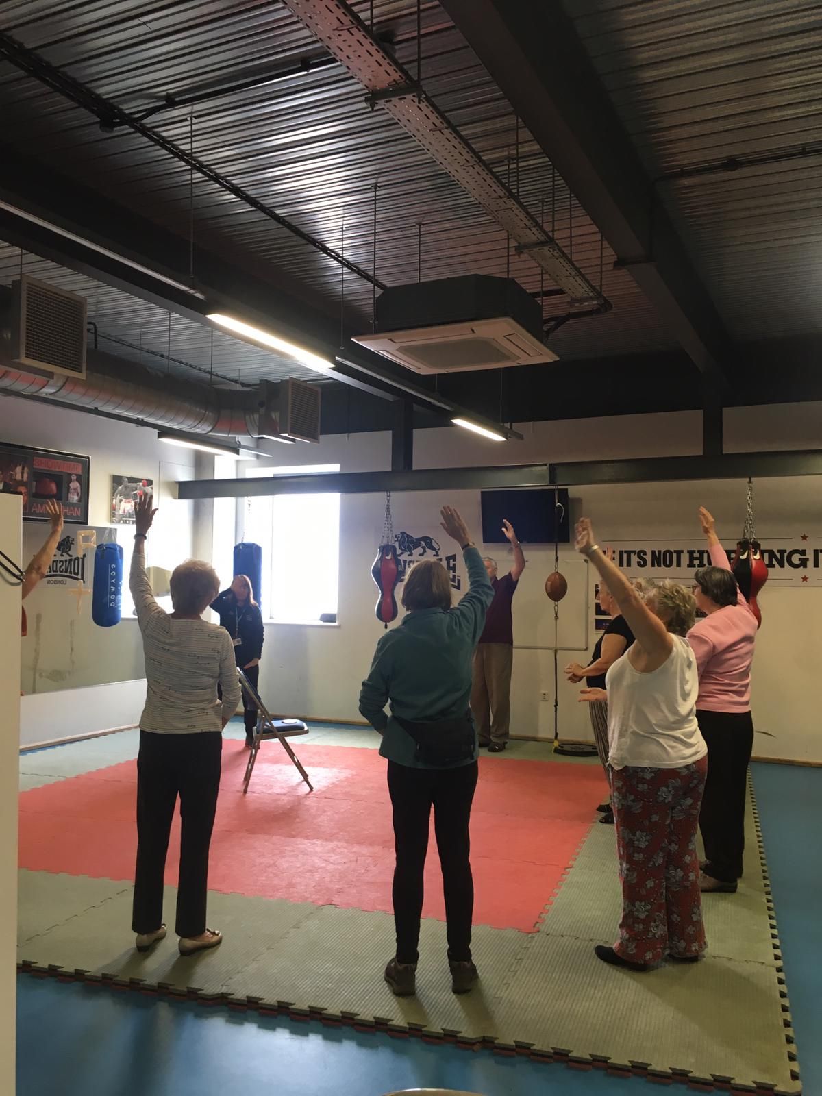
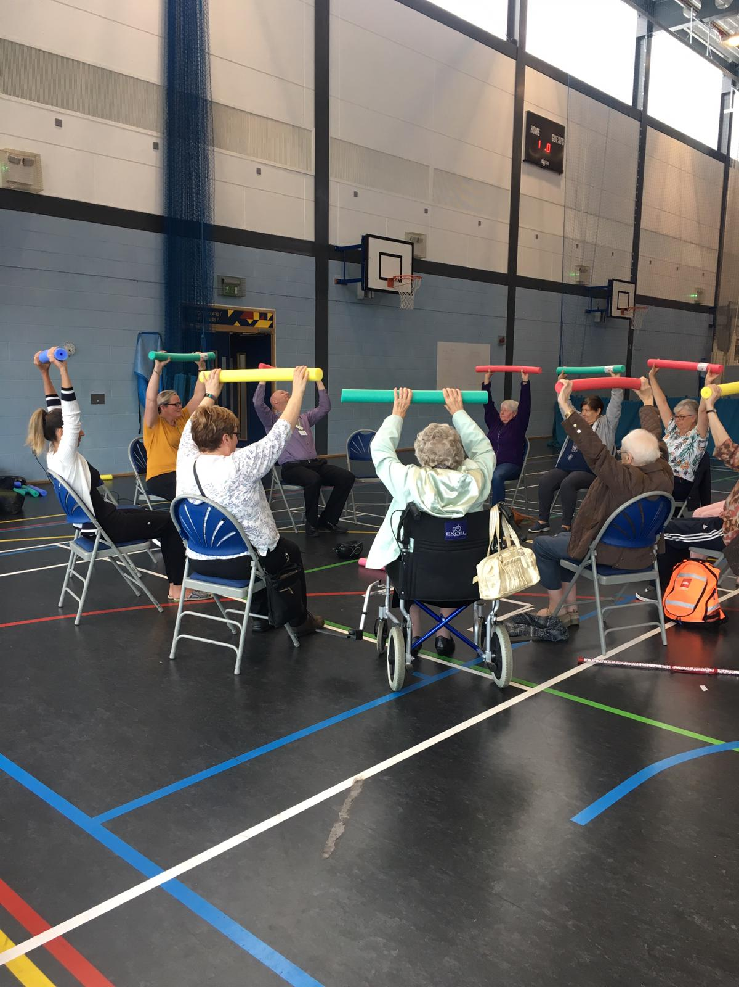
Recycled Teenagers
Wigan Youth Zone – 19th September 2019
Recycled Teenagers is an annual event which has been held at Wigan Youth Zone for the past 5 years. It is organised by the Deal for Communities team in partnership with a variety of services across the borough. The event is an opportunity for over 55’s to try new activities, meet different people, reunite with old friends and get more active and involved. Each year, the event has grown based on feedback from attendees. This year we welcomed 89 people to Wigan Youth Zone for a day filled with activities such as: Tai Chi, Bowling, Arts & Crafts, Strength and Balance, a social walk Mesnes Park, walking football and mindfulness. These sessions were delivered by Inspiring Healthy Lifestyles, Nomad Rangers, and Wigan Family and Local History Society. It was fantastic to see so many people getting involved in such a wide range of activities as well as trying something new for the first time.
Representation from 28 stall holders involving community services and groups were present to offer support and advice for attendees. Examples of stalls included: Age UK, Pensioners Link, Wigan Athletic Community Trust, Wigan Warriors Community Foundation, Leigh Hackspace, Embrace Wigan and Leigh, Bowl and Plate community group and Driven CIC. Entertainment was also given by Mike and Me, a duo who have an active presence with dementia cafes across the borough.
The event was enjoyed by all attendees and feedback was collated. This will be reviewed and planned into the Recycled Teenagers event in 2020! Watch this space for more details to come …
“A fantastic day learning about the groups and services that are available across the borough for myself and my friend, we have taken lots of information and have been involved with lots of activities – a great way to spend the day!”
“A really well organised and inspiring event for the older generation of Wigan. It is overwhelming to have so many great stalls and activities to get involved with. We will definitely come back next year! Thank you.”
Notes:
Joanne: First off I just want to touch on a bit of house keeping - toilets, drinks, & mobile phones if there's a fire

Slide 12
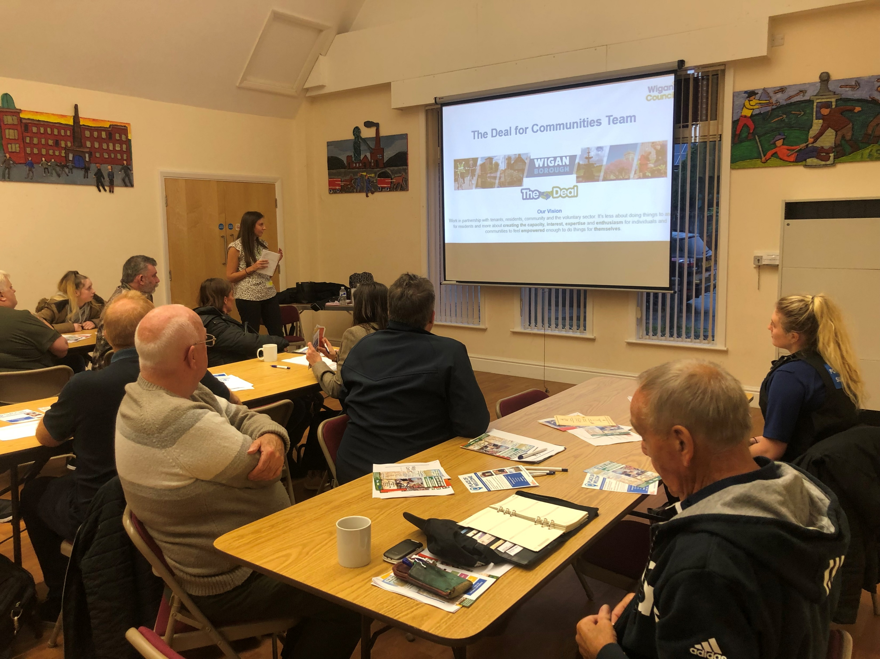
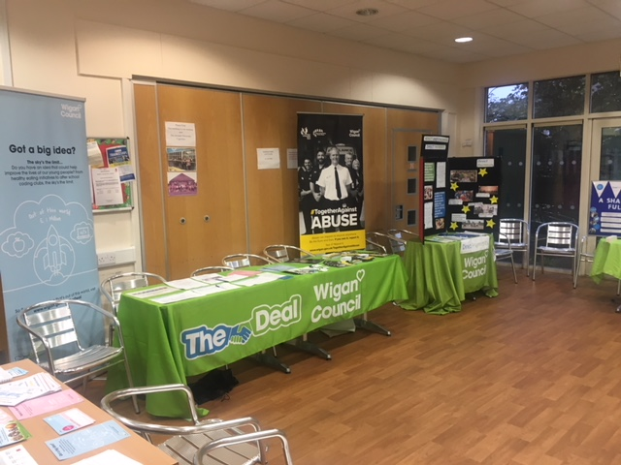
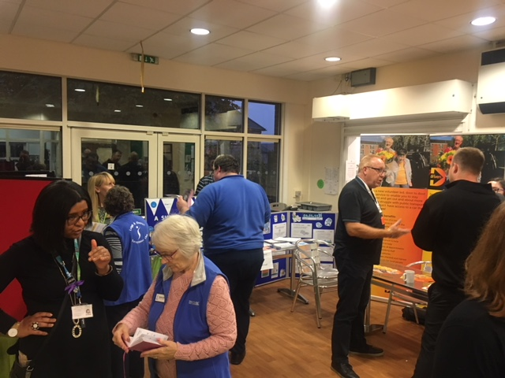
Community Network Event
Shakerley Community Centre, 30th September 2019
This event was organised by Helen Donlon, Community Capacity Officer and Joanne Berry, SDF manager. Our main focus of work targeted the areas of Atherton, Astley, Tyldesley and Mosley Common. This event was an opportunity for community groups and volunteers to integrate and network with each other. This was a fantastic way to allow groups to understand what each other do, as well as realising how they could work together and collaborate their services to benefit the surrounding community.
An overview of the Deal for Communities Investment Fund was given by Helen Donlon. This presentation allowed the Deal for Communities team offer to allow groups to understand the role of Community Capacity Officers and their responsibilities surrounding consultation, engagement, the investment fund and various ongoing boroughwide projects. In total, 34 representatives from a variety of community groups attended this event and each had different motives and reasons for attending. A few of these organisations included: Driven CIC, Atherton Collieries Womens FC, Boomers and Swingers Driving Range, Atherton Carnival Committee, Place of Welcome – Tyldesley, Salvation Army – Atherton, and The Green Grass Centre Hag Fold. Feedback was taken on the evening and this will be reviewed and taken into consideration when planning for the next event.
Support was also given from frontline services such as: Greater Manchester Police, Target Services, Community Support Workers, Shared Lives, Start Well and Safeguarding. Having these services present allowed any issues or concerns to be voiced and shared between groups.
“It was really useful for me to meet other groups in surrounding communities, we have shared ideas on how we could work together with our projects and ideas”
“As a new voluntary group in the area, it was fantastic for us to be able to get to know businesses in the community as well as the services that are available”
Notes:
Joanne: First off I just want to touch on a bit of house keeping - toilets, drinks, & mobile phones if there's a fire

Slide 13
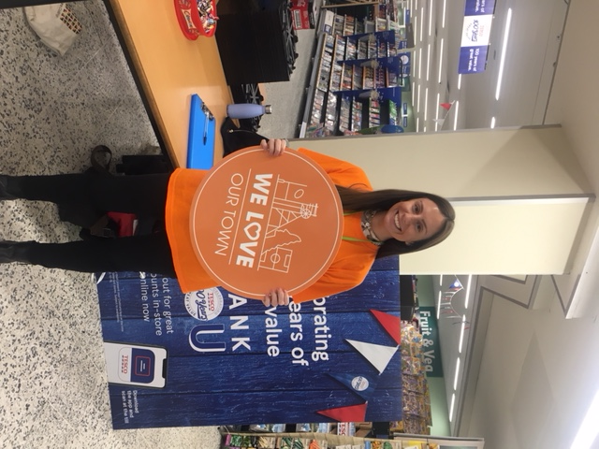
Our Town Consultation
Atherton Tesco Store – Friday 27th September 2019
Tyldesley Iceland Store – Tuesday 1st October 2019
Following our Big Listening Project Consultation that took place in Autumn 2018, it was clear that residents want to live in an area that they can be proud of.
Our residents told us that community was a really important part of day-to-day life. Knowing neighbours, keeping in touch with those nearby and being a friendly place to live was at the heart of this borough and key to its success.
The Our Town campaign aims to build on this sense of community and pride by bringing people together to share their stories and to celebrate our borough, its culture and heritage, its beauty and the people that make it great. The #WeLove statement is being used to prompt people into being passionate about their hometown and is a way to share nostalgic feeling and memories of a time or place.
It was clear to us that residents feel a deep sense of belonging to their individual wards rather than the wider borough which is where the #WeLove campaign comes in. Tailored to each ward, the #WeLove campaign will address the issues raised during the consultation.
As the Community Capacity Officer for the Atherton, Tyldesley, Astley and Mosley Common SDF – I took part in the consultations that were scheduled for both the Atherton and Tyldesley Town Centre’s. It was a fantastic opportunity not only to support this corporate campaign, but also to engage and consult with residents across the areas that I cover as a Community Capacity Officer. I was able to listen to local people’s concerns and issues, in order to understand where there may be any gaps in our community engagement work. I was also able to be acquainted with local people who have so much passion for where they live and listen to their stories and attachments to their area and the Wigan Borough.
A short questionnaire was taken, allowing the campaign to have evidence to show what people love, like and dislike about their areas. It will help the Council’s plans to develop, regenerate and invest into communities through any gaps that are identified.
“I was able to speak to a gentleman who had lived in the borough for 72 years. He had lived and worked here all of his life and now retires with his wife of 50 years and their family.
“It is great to see the Council wanting to learn about areas further afield in the borough. As a resident I feel incredibly attached to my local area yet not as connected to the Wigan Borough as a whole. Hopefully this will change as an outcome of the campaign”
Notes:
Joanne: First off I just want to touch on a bit of house keeping - toilets, drinks, & mobile phones if there's a fire

Slide 14
Closing Statement …
Thank you all so much for reading my first community blog! I do hope that you found this interesting and a great way to keep up to date with my day to day work. This is only a small insight and selection into some of the projects that I have been involved with or visited over the past few months. I hope that my next blog will showcase even more fantastic examples of the wonderful work that is going on across the Atherton, Astley, Tyldesley and Mosley Common areas.
If you have any questions or require any further information, or if you would like me to support you with an upcoming project, visit your facility or provide any advice – please feel free to get in touch.
For any other general enquiries, please contact – thedealforcommunities@wigan.gov.uk or Telephone 01942 486557
Best wishes, Helen.

